Slide 1


Xcode Career Service
关注 Xcode 即可获得热腾腾的高频题解析视频、面试技巧及准备tips、北美IT就业咨询等干货
一对一实习或工作信息咨询服务
一对一面试能力评定 + 修改简历
一对一Mock interview强化训练服务

Slide 2
想进 xcode 的刷题群，请加老师微信 singerdmx， 他会拉你进群

Slide 3
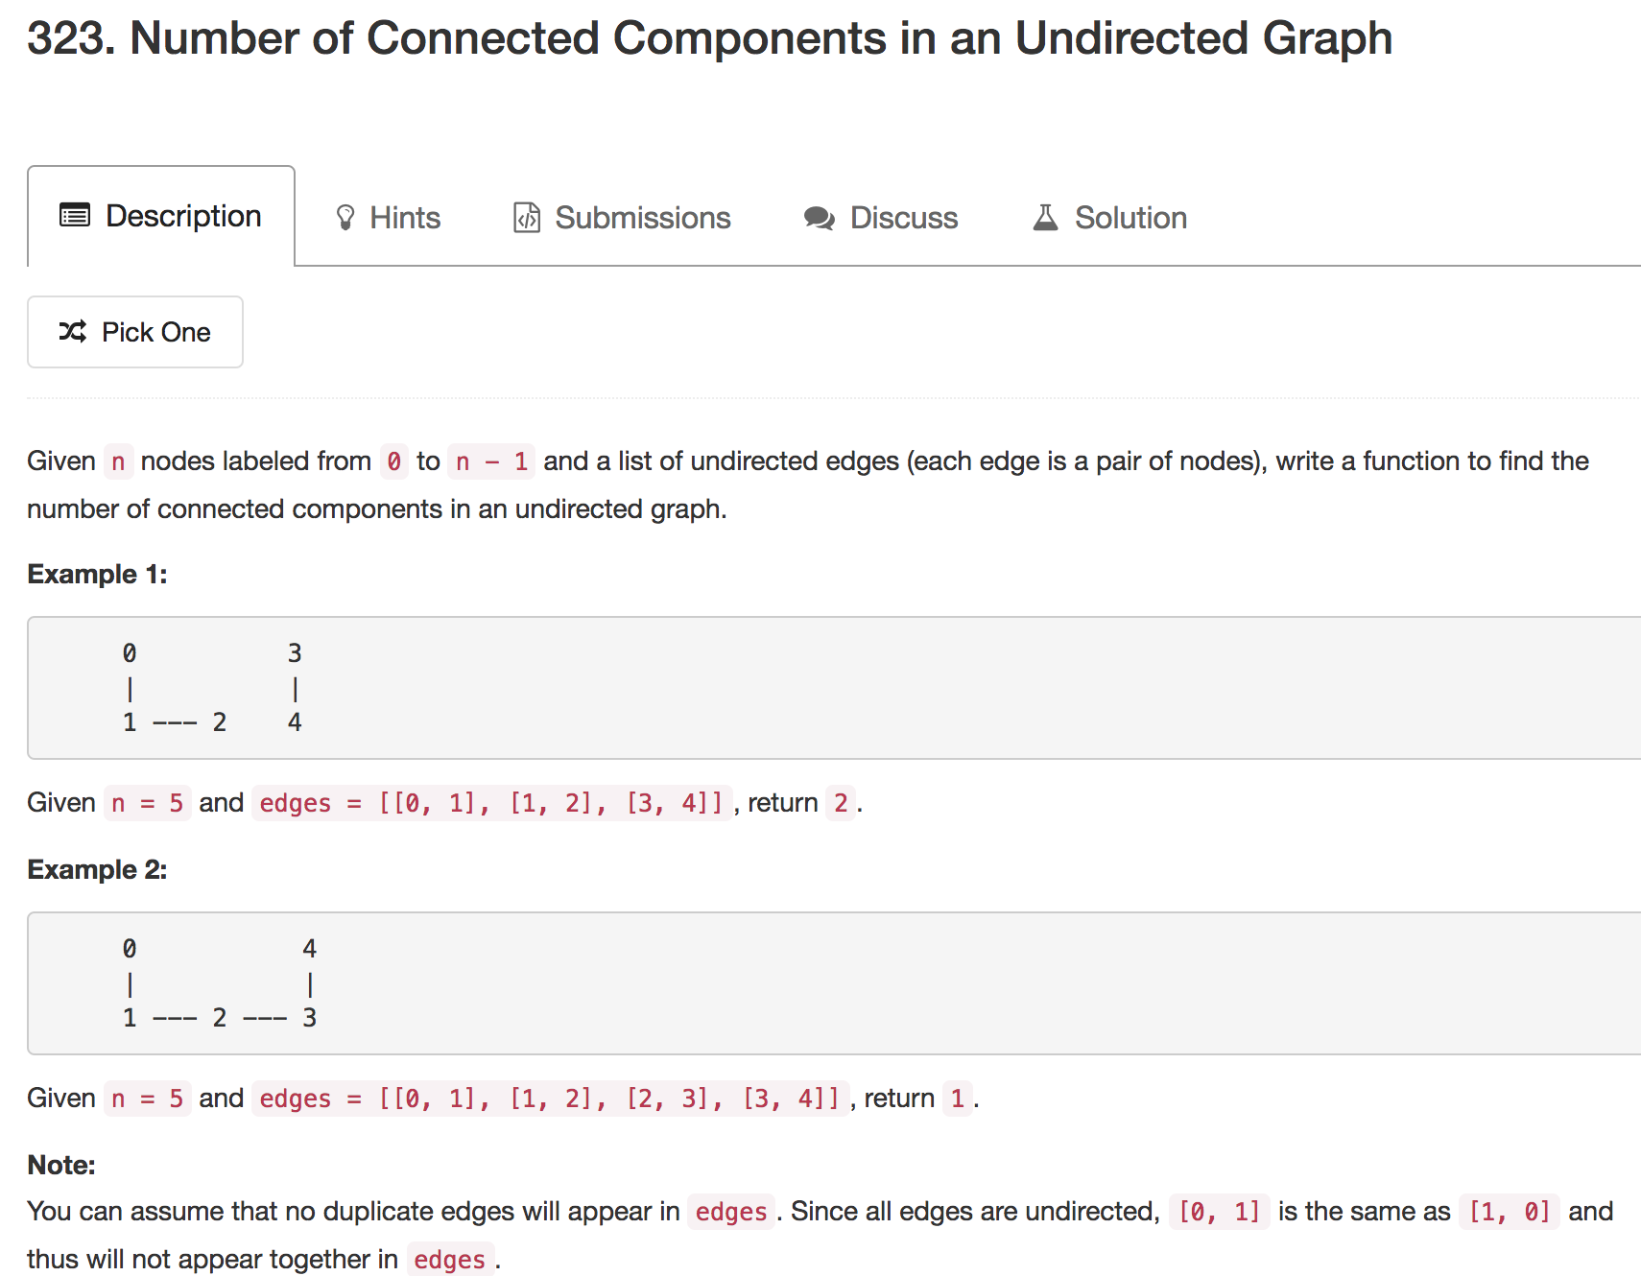
Mock
BFS
DFS
Union Find

Slide 4

Graph / Search

Slide 5
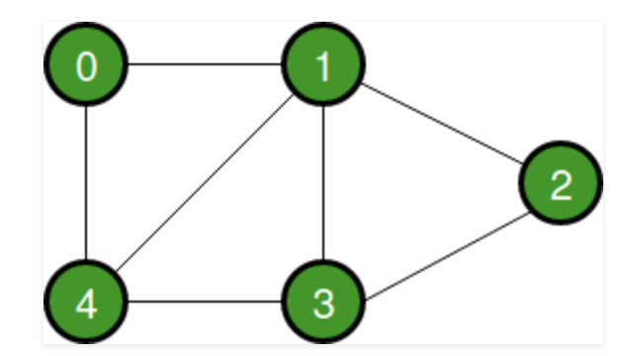
Graph
A finite set of vertices also called as nodes
A finite set of ordered pair of the form (u, v) called as edge
(u, v) is the same as (v, u): undirected graph
(u, v) is not the same as (v, u): directed graph

Slide 6

Representation of Graph
1. Adjacency Matrix 2. Adjacency List

Slide 7
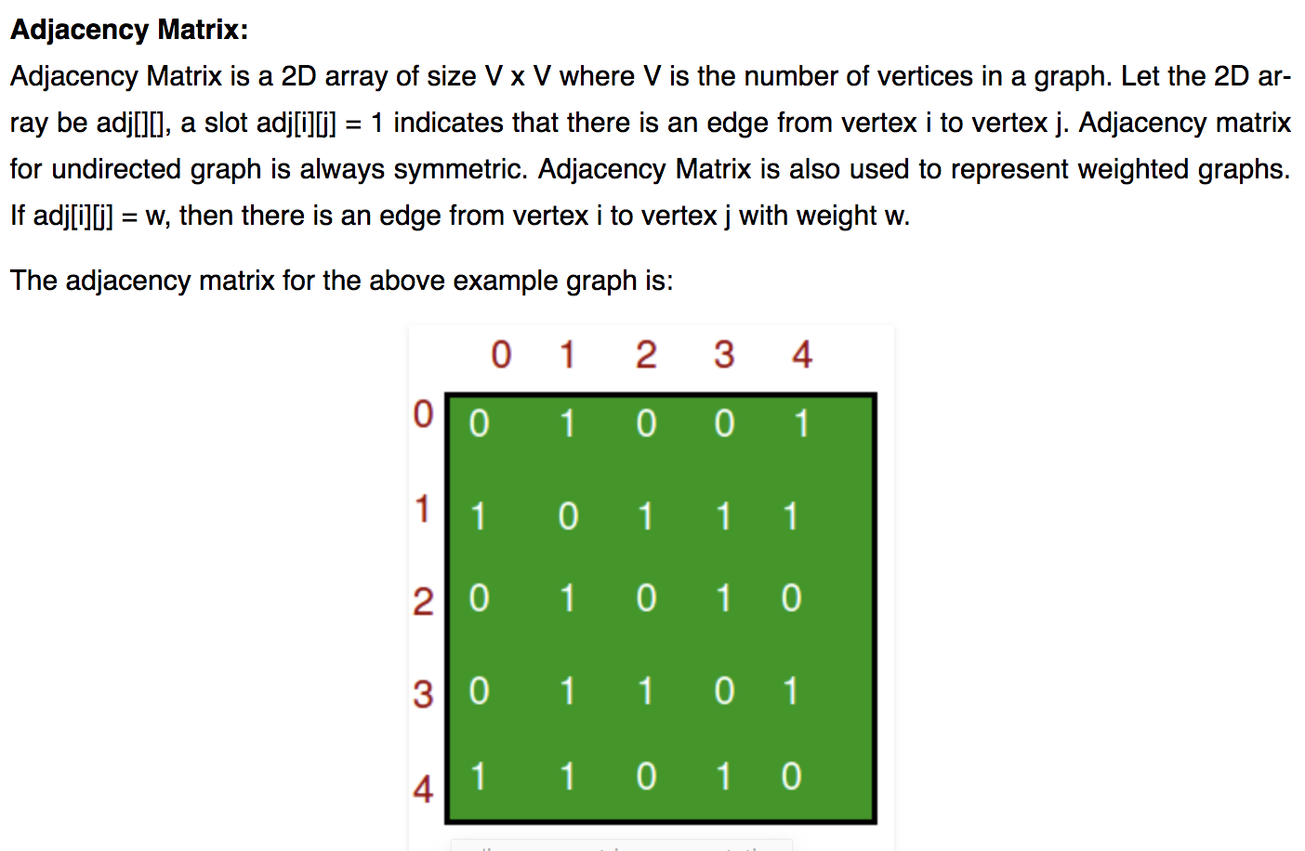

Slide 8
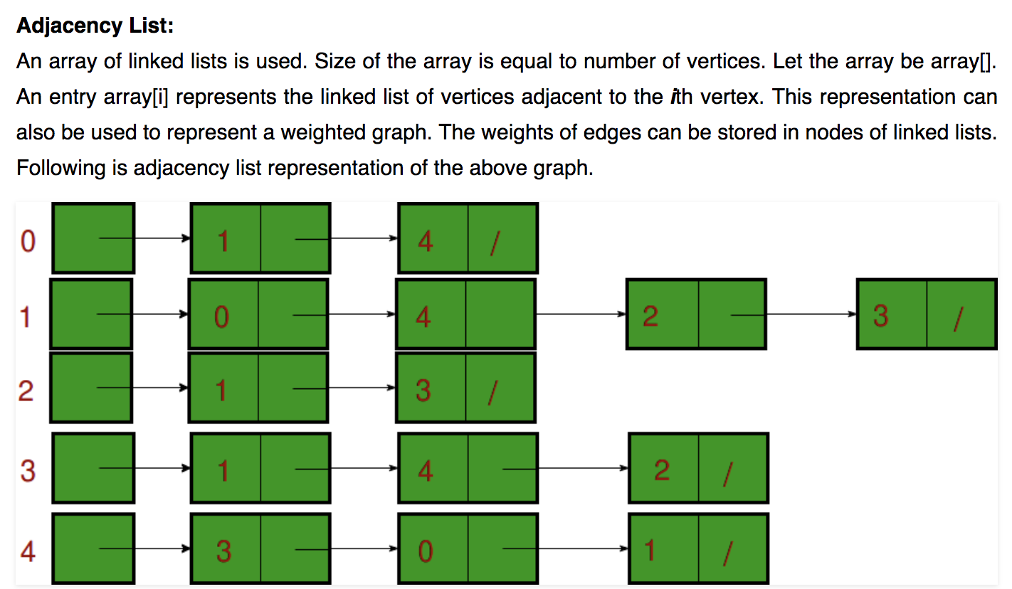

Slide 9
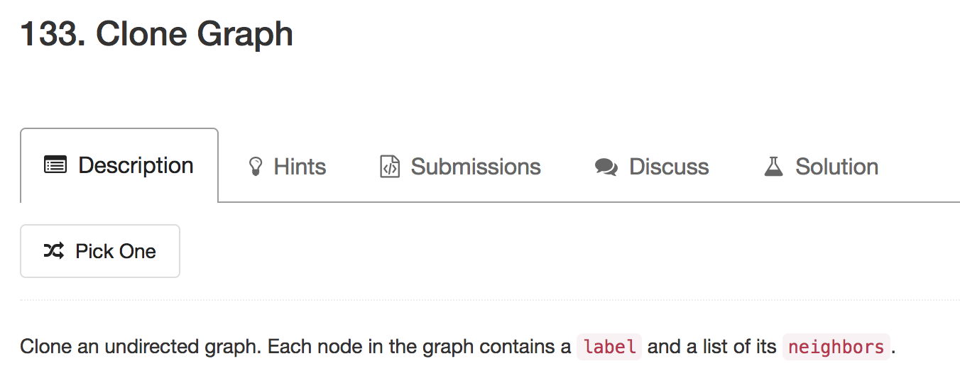
BFS & DFS

Slide 10
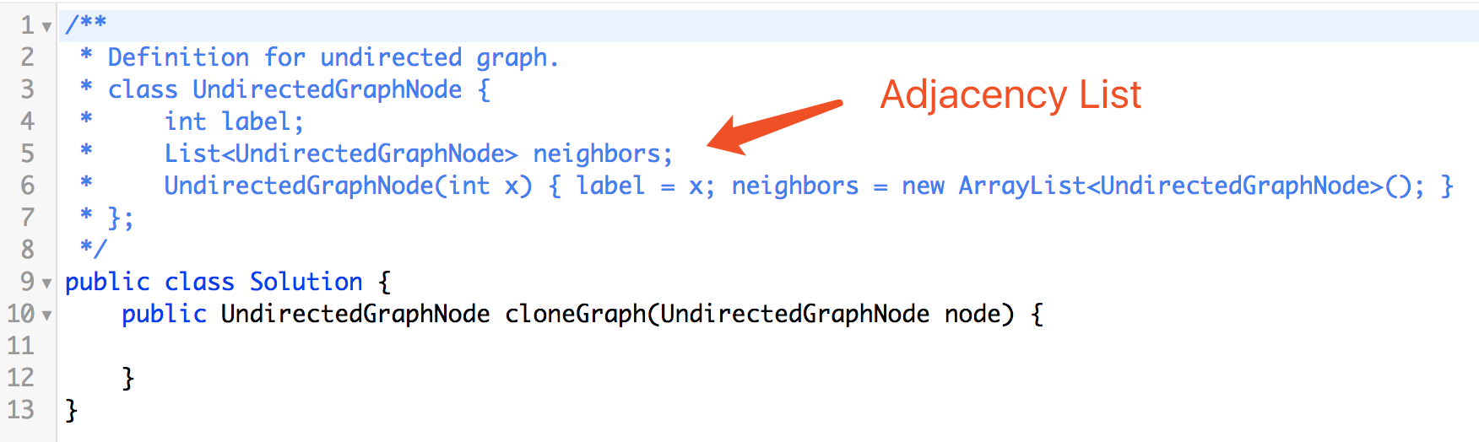
A graph is simply represented by a graph node that serves as its starting point. In fact, the starting point could be any other graph nodes and it does not affect the cloning algorithm.

Slide 11
Mapping
Map<UndirectedGraphNode, UndirectedGraphNode>
<0, 0’>
<1, 1’>
<2, 2’>
<3, 3’>
<4, 4’>
0
0’
1
2
1’
2’
4
3
4’
3’

Slide 12
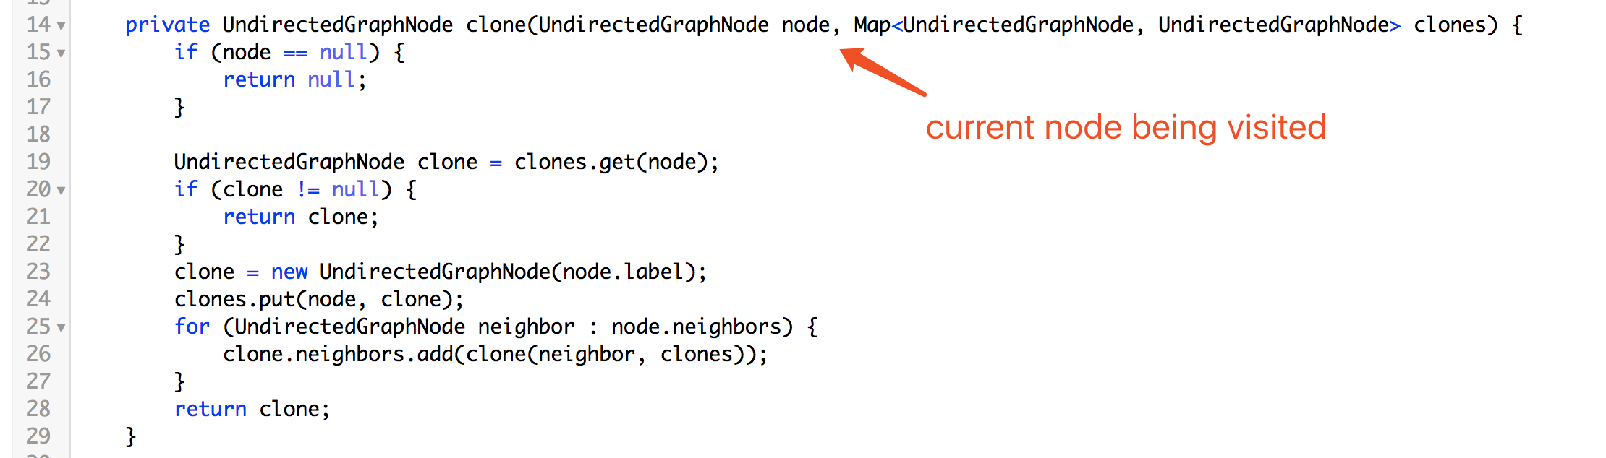
DFS
Define Recursive Function

Slide 13
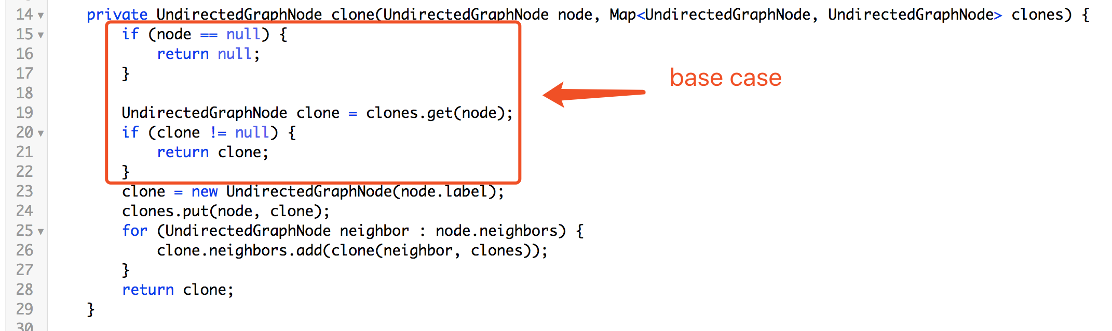

Slide 14
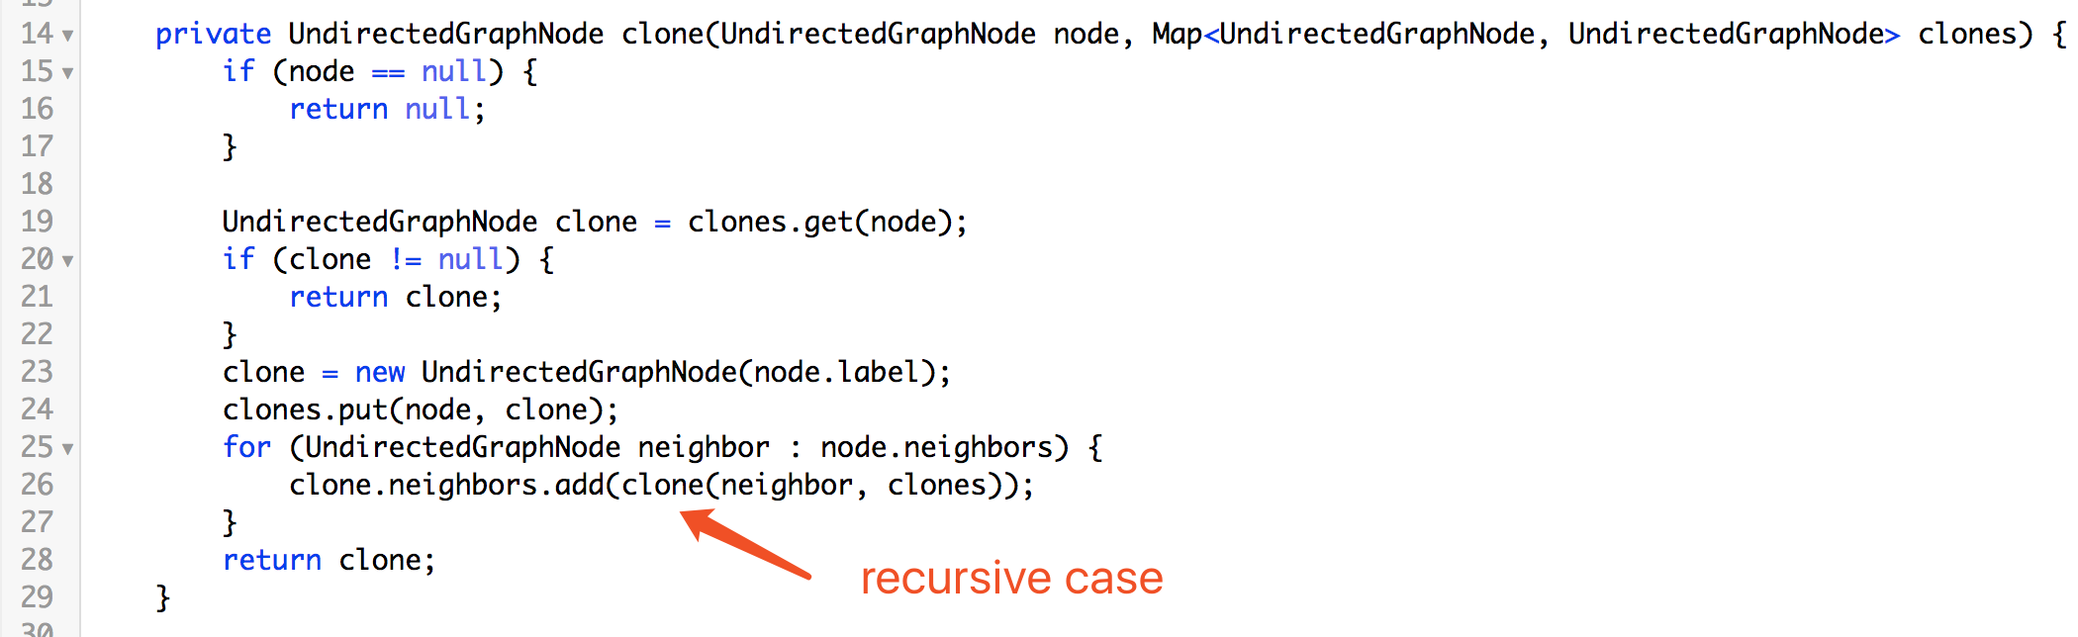

Slide 15
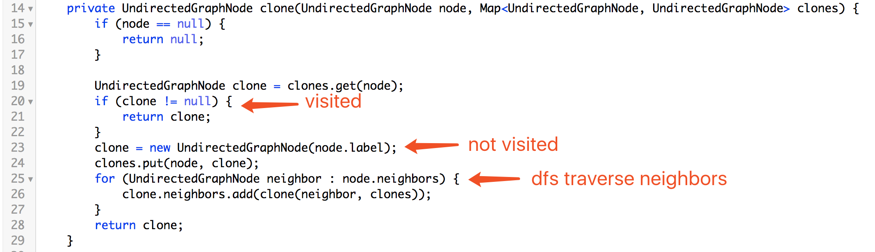

Slide 16
node: 0
clone: null
clones: <>
0
1
2
4
3

Slide 17
node: 0
neighbors: 1
clone: 0’
clones:
<0, 0’>
0
0’
1
2
4
3

Slide 18
node: 1
clone: null
clones:
<0, 0’>
0
0’
1
2
4
3

Slide 19
node: 1
neighbors: 2
clone: 1’
clones:
<0, 0’>
<1, 1’>
0
0’
1
2
1’
4
3

Slide 20
node: 2
clone: null
clones:
<0, 0’>
<1, 1’>
0
0’
1
2
1’
4
3

Slide 21
node: 2
neighbors: 3, 4
clone: 2’
clones:
<0, 0’>
<1, 1’>
<2, 2’>
0
0’
1
2
1’
2’
4
3

Slide 22
node: 3
clone: null
clones:
<0, 0’>
<1, 1’>
<2, 2’>
0
0’
1
2
1’
2’
4
3

Slide 23
node: 3
neighbors: 2, 4
clone: 3’
clones:
<0, 0’>
<1, 1’>
<2, 2’>
<3, 3’>
0
0’
1
2
1’
2’
3’
4
3

Slide 24
node: 4
clone: null
clones:
<0, 0’>
<1, 1’>
<2, 2’>
<3, 3’>
0
0’
1
2
1’
2’
3’
4
3

Slide 25
node: 4
neighbors: 2, 3
clone: 4’
clones:
<0, 0’>
<1, 1’>
<2, 2’>
<3, 3’>
<4, 4’>
0
0’
1
2
1’
2’
4’
3’
4
3

Slide 26
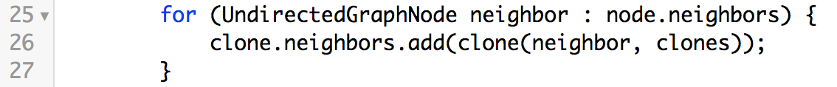
node: 3
clones:
<0, 0’>
<1, 1’>
<2, 2’>
<3, 3’>
<4, 4’>
0
0’
1
2
1’
2’
4’
3’
4
3

Slide 27
node: 2
clones:
<0, 0’>
<1, 1’>
<2, 2’>
<3, 3’>
<4, 4’>
0
0’
1
2
1’
2’
4’
3’
4
3

Slide 28
node: 1
clones:
<0, 0’>
<1, 1’>
<2, 2’>
<3, 3’>
<4, 4’>
0
0’
1
2
1’
2’
4’
3’
4
3

Slide 29
node: 0
clones:
<0, 0’>
<1, 1’>
<2, 2’>
<3, 3’>
<4, 4’>
0
0’
1
2
1’
2’
4’
3’
4
3

Slide 30
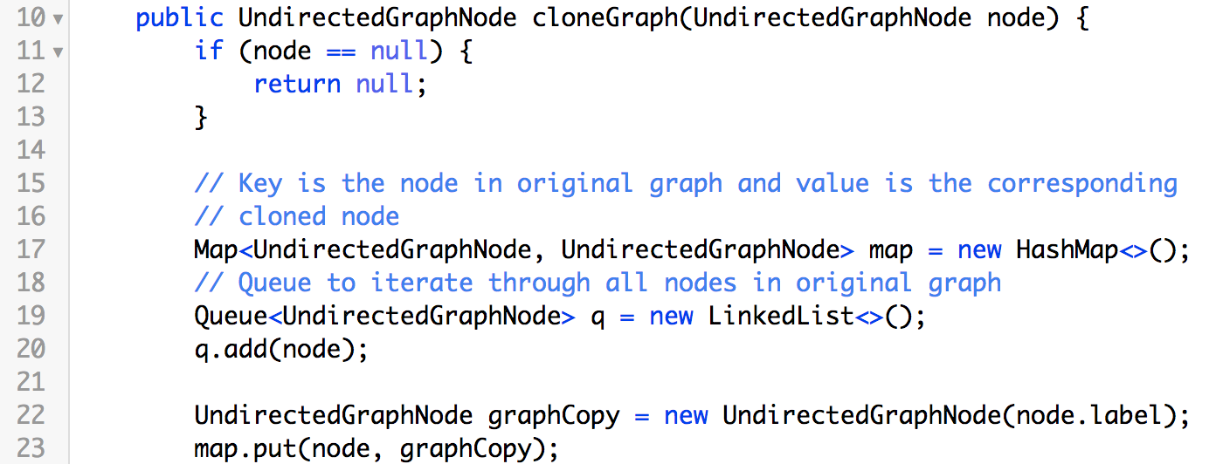
BFS

Slide 31
node: 0
graphCopy: 0’
q: [0]
map:
<0, 0’>
0
0’
1
2
4
3

Slide 32
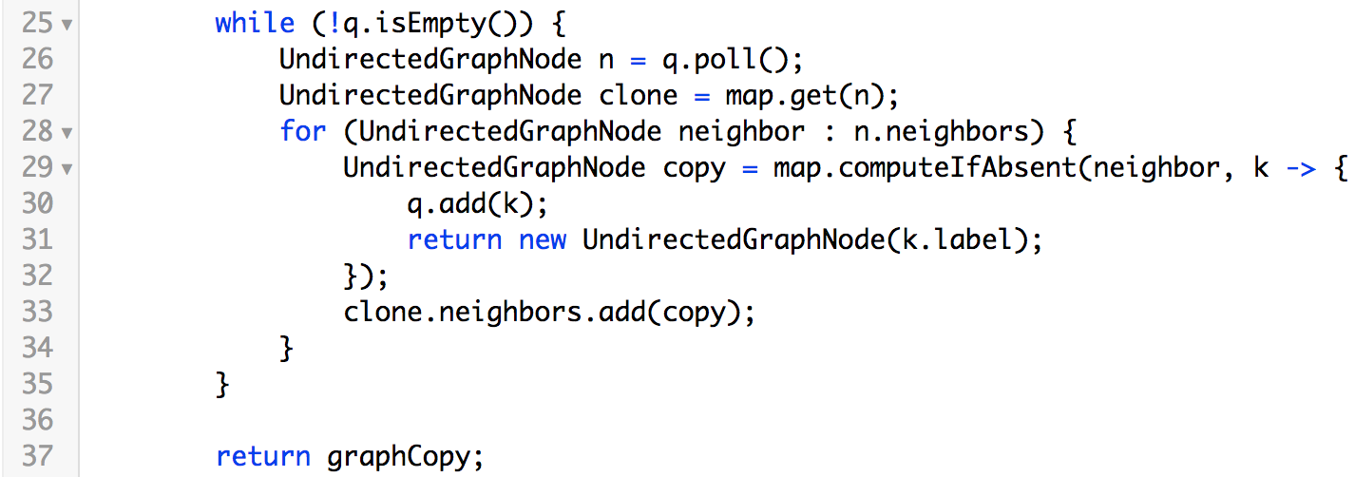

Slide 33
n: 0
neighbors: 1
clone: 0’
q: []
map:
<0, 0’>
0
0’
1
2
4
3

Slide 34
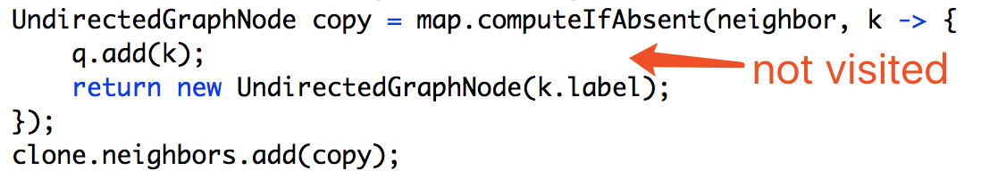
n: 0
neighbors: 1
clone: 0’
q: [1]
map:
<0, 0’>
<1, 1’>
0
0’
1
2
1’
4
3

Slide 35
n: 1
neighbors: 2
clone: 1’
q: []
map:
<0, 0’>
<1, 1’>
0
0’
1
2
1’
4
3

Slide 36
n: 1
neighbors: 2
clone: 1’
q: [2]
map:
<0, 0’>
<1, 1’>
<2, 2’>
0
0’
1
2
1’
2’
4
3

Slide 37
n: 2
neighbors: 3, 4
clone: 2’
q: []
map:
<0, 0’>
<1, 1’>
<2, 2’>
0
0’
1
2
1’
2’
4
3

Slide 38
n: 2
neighbors: 3, 4
clone: 2’
q: [3, 4]
map:
<0, 0’>
<1, 1’>
<2, 2’>
<3, 3’>
<4, 4’>
0
0’
1
2
1’
2’
3
4’
3’
4

Slide 39
n: 3
neighbors: 2, 4
clone: 3’
q: [4]
map:
<0, 0’>
<1, 1’>
<2, 2’>
<3, 3’>
<4, 4’>
0
0’
1
2
1’
2’
3
4’
3’
4

Slide 40
n: 4
neighbors: 2, 3
clone: 4’
q: [4]
map:
<0, 0’>
<1, 1’>
<2, 2’>
<3, 3’>
<4, 4’>
0
0’
1
2
1’
2’
3
4’
3’
4

Slide 41
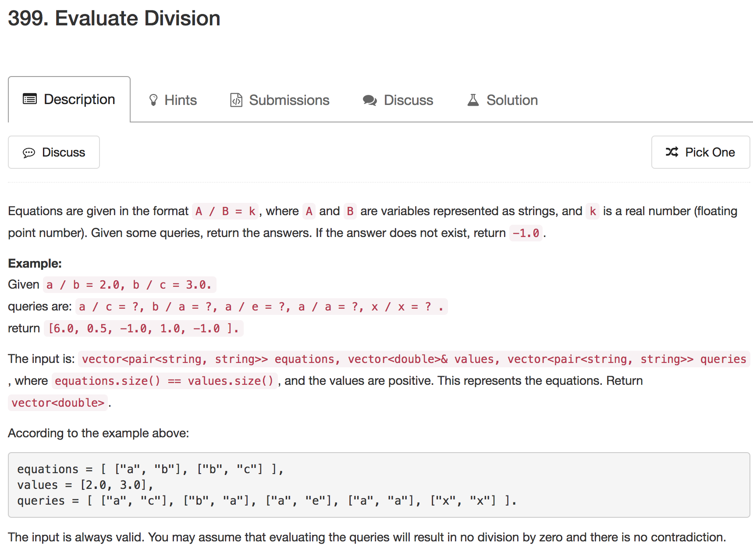

Slide 42
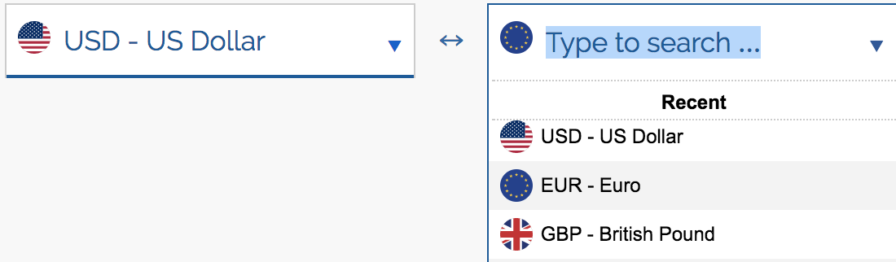
Variation
Currency Exchange

Slide 43
Graph
DFS
Recursion

Slide 44
B
2.0
1 / 2.0
A
3.0
1 / 3.0
C

Slide 45
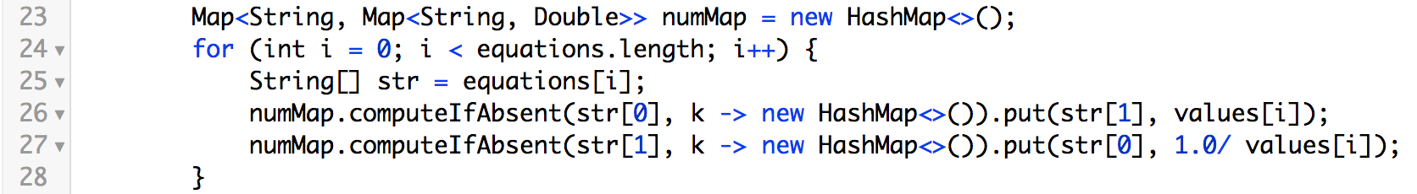
numMap
A: < (B, 2.0) >
B: < (A, 0.5), (C, 3.0) >
C: < (A, 0.3) >

Slide 46
Set<String> visitedSet
B
A:B
B:A
A
B:C
C:B
C

Slide 47
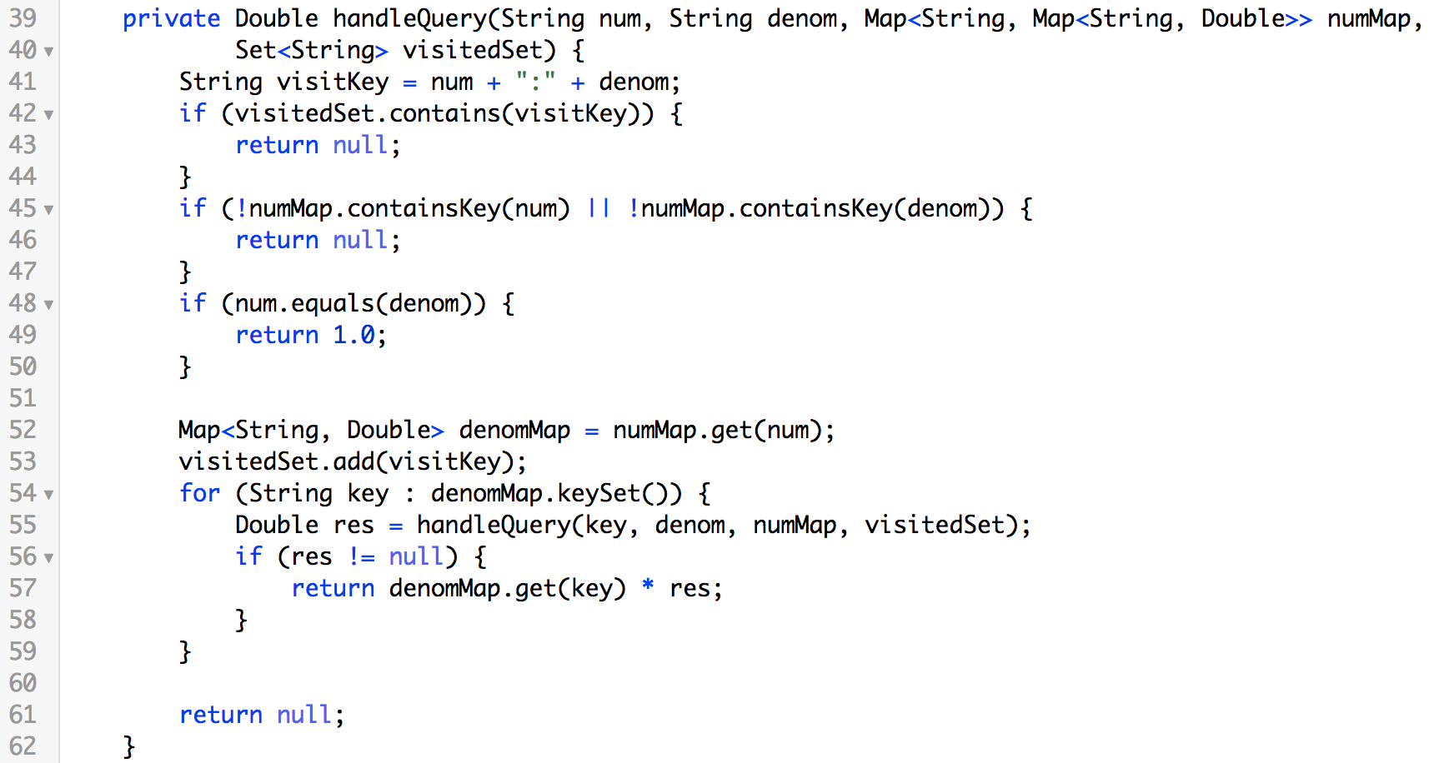

Slide 48
A
A:B
B
B:C
C
2.0 * 3.0
3.0 * 1.0
num: A
denom: B
visitedSet: <>
num: B
denom: C
visitedSet: <A:B>
num: C
denom: C
visitedSet: <A:B, B:C>

Slide 49
Topological Sort
Sorting technique over DAGs (Directed Acyclic Graphs)
It creates a linear sequence (ordering) for the nodes such that:
If u has an outgoing edge to v ➔ then u must finish before v starts
Very common in ordering jobs or tasks

Slide 50
Topological Sort Example
A job consists of 10 tasks with the following precedence rules:
Must start with 7, 5, 4 or 9.
Task 1 must follow 7.
Tasks 3 & 6 must follow both 7 & 5.
8 must follow 6 & 4.
2 must follow 4.
10 must follow 2.
Make a directed graph and then do DFS.

Slide 51
9
Tasks shown as a directed graph.
1
7
3
8
5
6
4
10
2

Slide 52
Topological Sort using DFS
To create a topological sort from a DAG
Remove vertex that has indegree of 0
Update other indegrees of other vertices who are neighbors of removed vertex
Go to 1

Slide 53
Example
9
1
7
3
8
5
6
4
10
2

Slide 54
Example
9
1
7
3
8
5
6
4
10
2

Slide 55
Example
9
1
5
7
3
8
5
6
4
10
2

Slide 56
Example
9
1
5, 9
7
3
8
6
4
10
2

Slide 57
Example
1
5, 9
7
3
8
6
4
10
2

Slide 58
Example
1
5, 9, 7
3
8
6
4
10
2

Slide 59
Example
1
5, 9, 7
3
8
6
4
10
2

Slide 60
Example
1
5, 9, 7, 6
3
8
4
10
2

Slide 61
Example
1
5, 9, 7, 6, 3
3
8
4
10
2

Slide 62
Example
1
5, 9, 7, 6, 3
8
4
10
2

Slide 63
Example
5, 9, 7, 6, 3, 1
8
4
10
2

Slide 64
Example
5, 9, 7, 6, 3, 1, 4
8
10
2

Slide 65
Example
5, 9, 7, 6, 3, 1, 4, 8
8
10
2

Slide 66
Example
5, 9, 7, 6, 3, 1, 4, 8
10
2

Slide 67
Example
5, 9, 7, 6, 3, 1, 4, 8, 2
10

Slide 68
Topological Sort: Summary
9
1
5, 9, 7, 6, 3, 1, 4, 8, 2, 10
7
3
The final order or jobs
8
5
6
Time complexity = DFS complexity O(V + E)
4
There can be many orders that meet the requirements
10
2

Slide 69
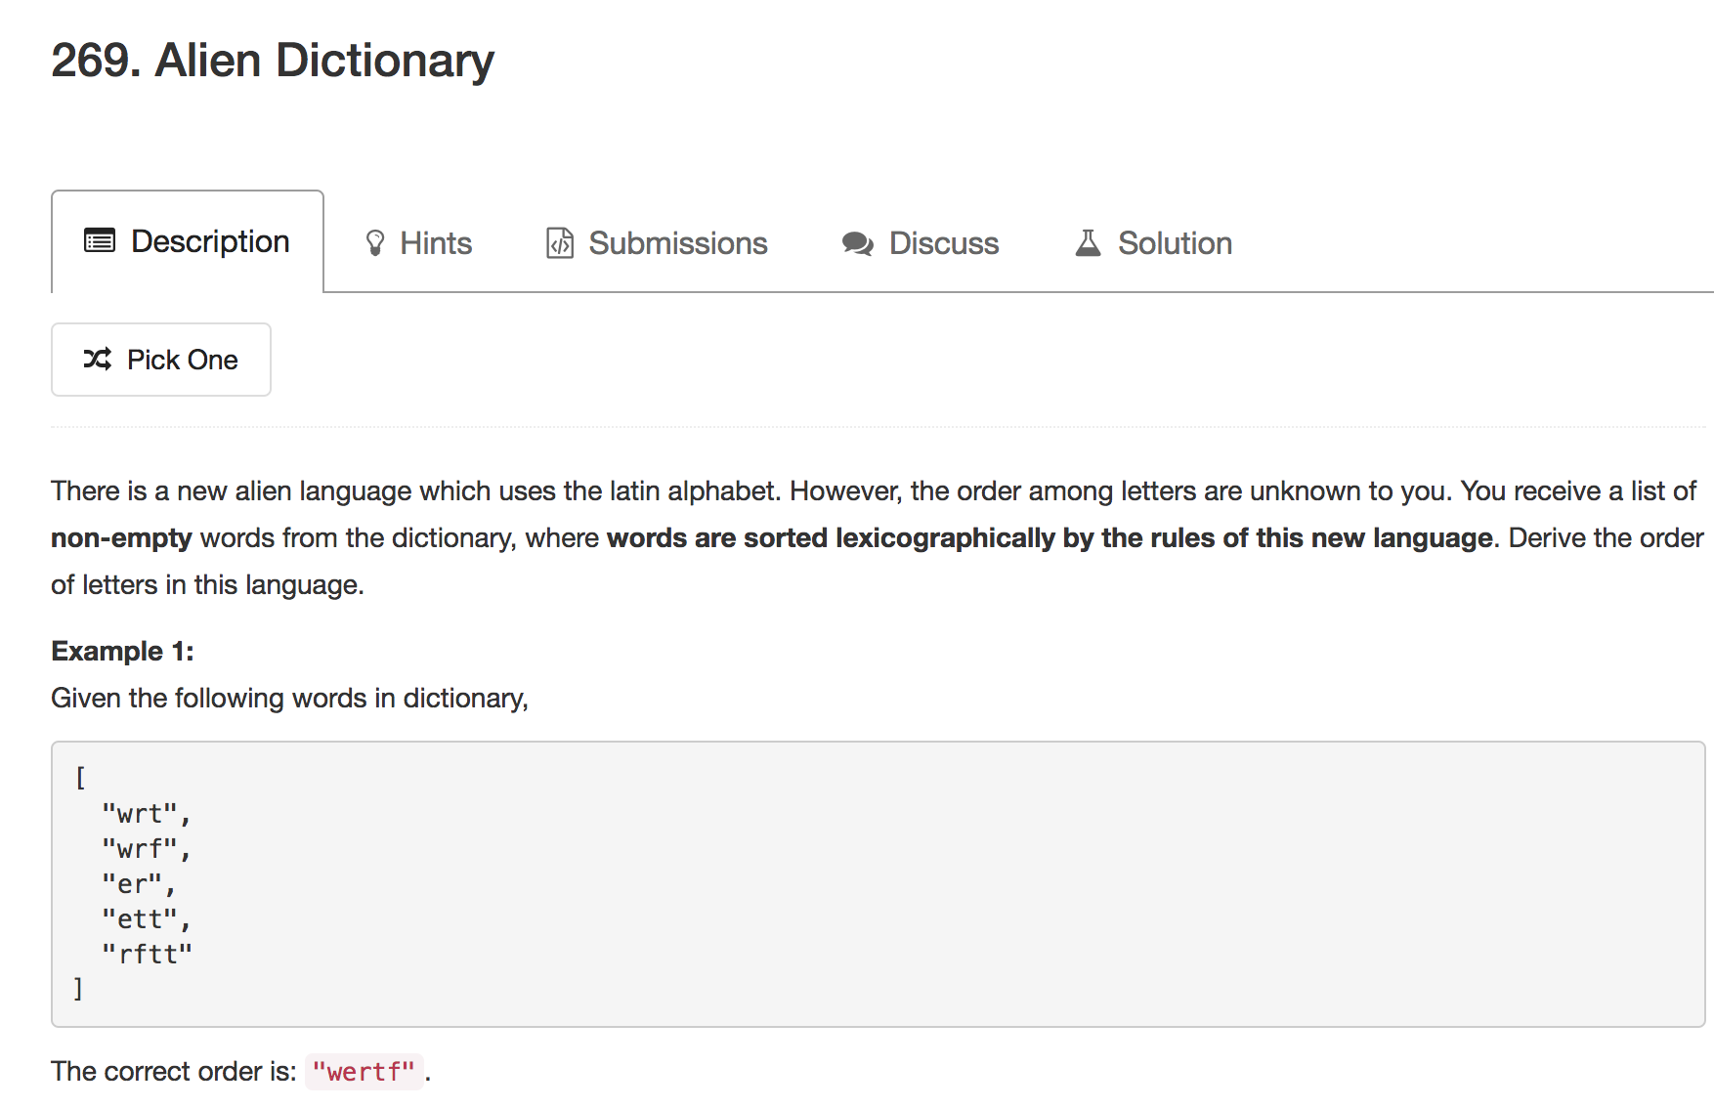

Slide 70
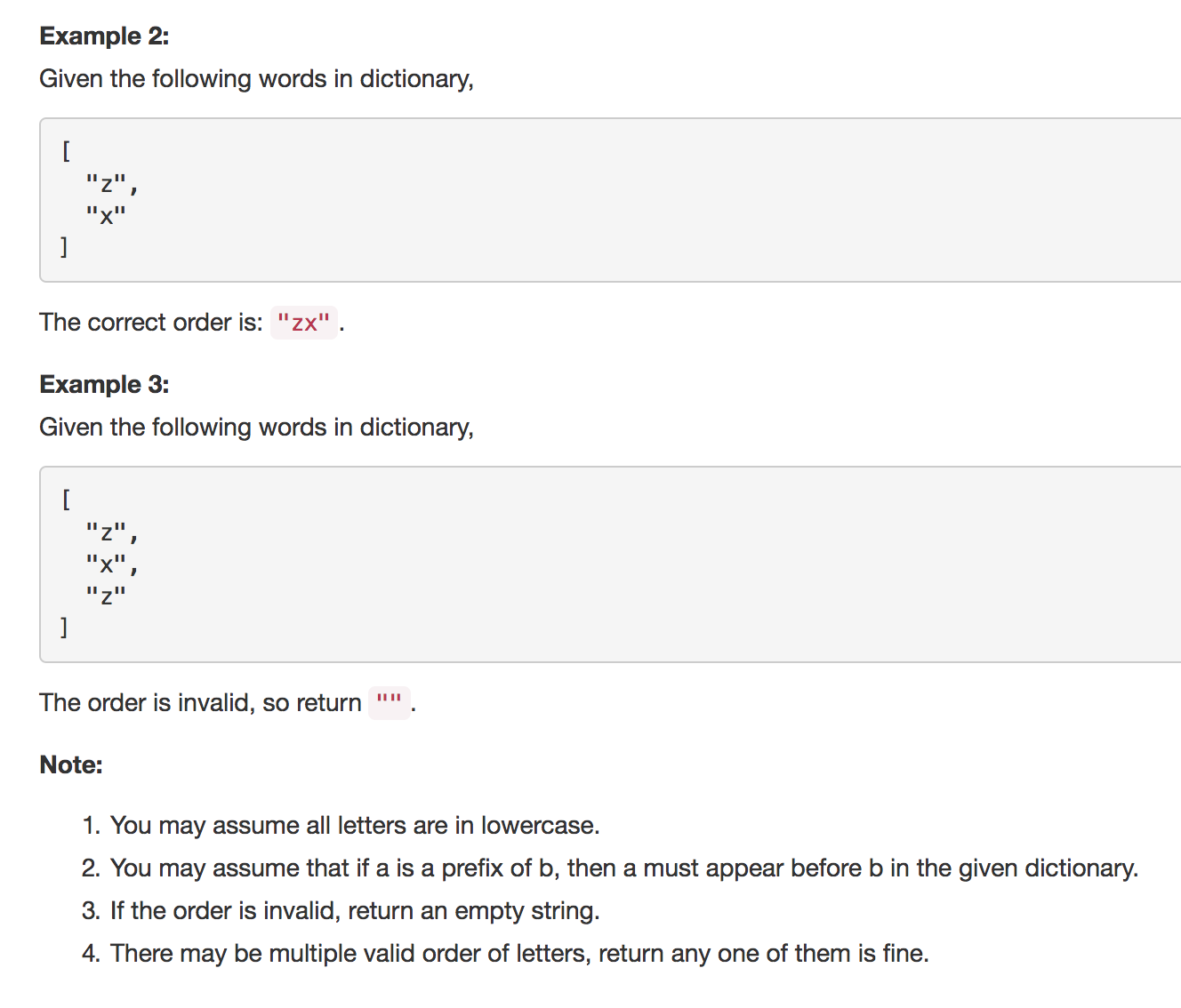

Slide 71
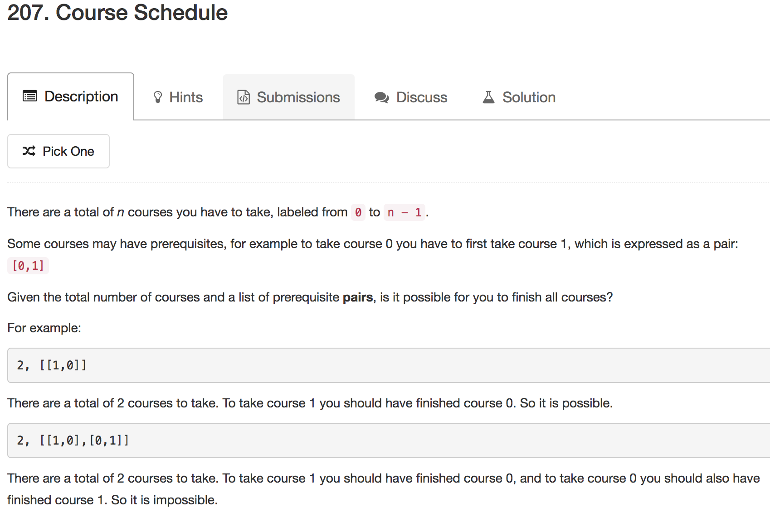

Slide 72
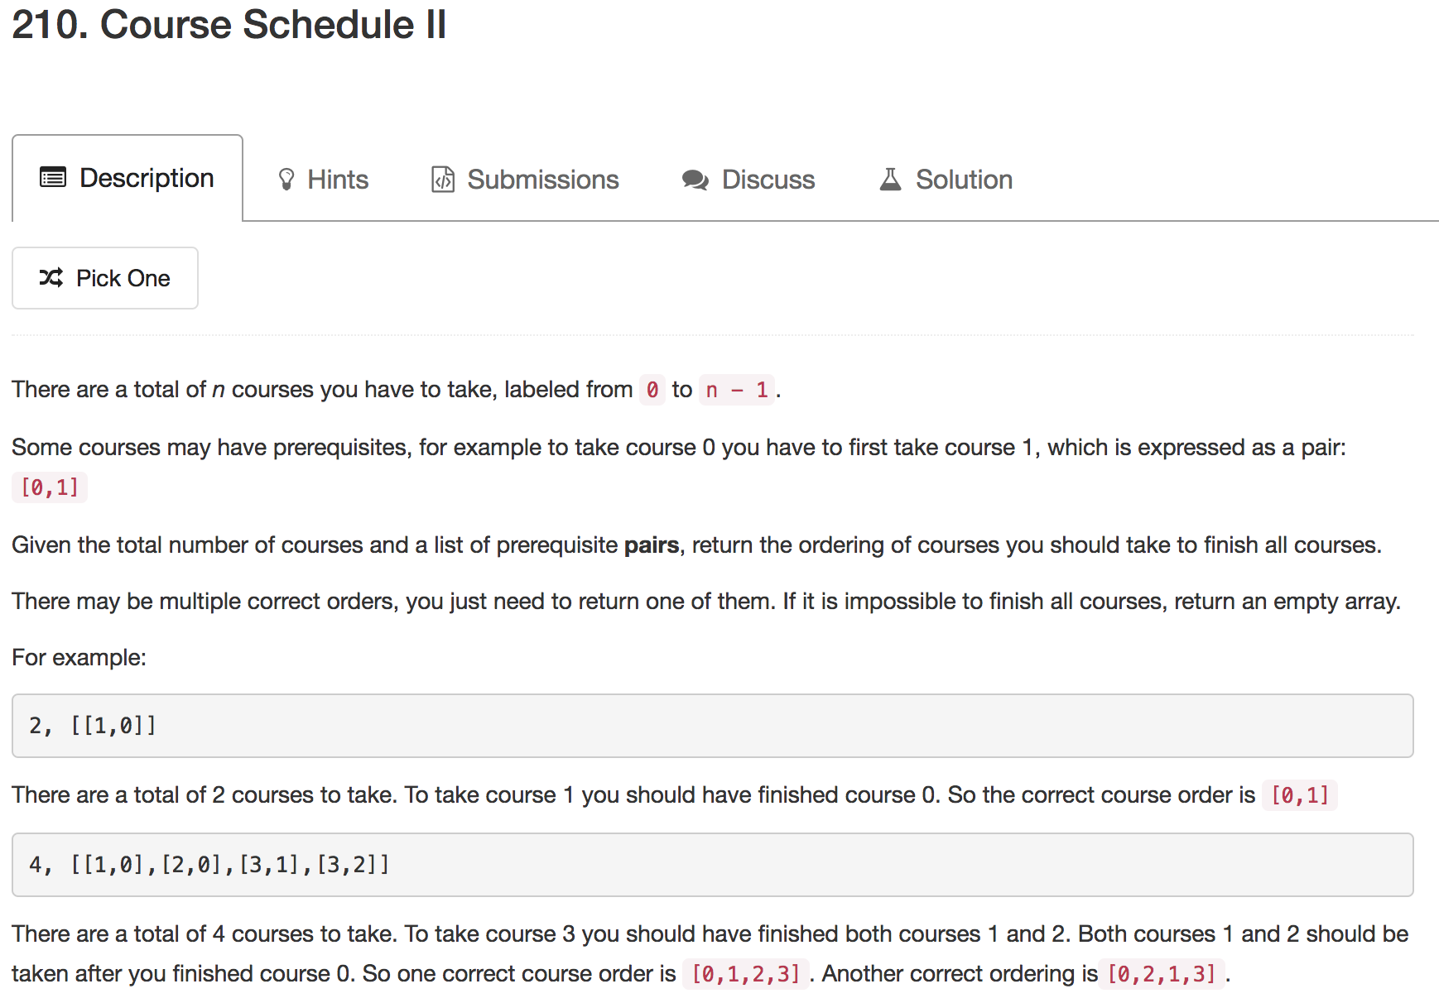

Slide 73
Xcode Career Service
有任何问题，请咨询 xc0d3@outlook.com

